Slide 1




Inspiring a Love of Reading

Slide 2


Honouring Traditional Territories
We would like to acknowledge the traditional lands of the First Nations, Inuit, and Métis, and honour all Indigenous peoples past, present, and future who continue to work, educate and contribute to the strength of our country.
HONOURING TRADITIONAL TERRITORIES

Slide 3

The Indigo Love of Reading Foundation
Every child deserves to fall in love with reading...
Now in its 17th year, The Indigo Love of Reading Foundation has been on a mission to ensure that EVERY Canadian child has the opportunity to become richly literate and achieve their full potential through reading.
THE INDIGO LOVE OF READING FOUNDATION

Slide 4

The Indigo Love of Reading Foundation
Through transformative multi-year grants, responsive community outreach programs, and other core fundraising initiatives, the Foundation reaches for this goal through the revitalization of public elementary school libraries and the delivery of literacy programming and resources to high-needs communities across Canada.
There is no audio for this slide
THE INDIGO LOVE OF READING FOUNDATION

Slide 5

There is no audio for this slide
Together, with Indigo, its customers, and its employees,
we have committed $33 million to over 3000 high-needs schools, impacting more than 1 million children.
THE INDIGO LOVE OF READING FOUNDATION

Slide 6

There is no audio for this slide
The Critical Thinking Consortium (TC²)
Our aim is to work in sound, sustained ways with educators and related organizations to inspire, support, and advocate for the infusion of critical, creative, and collaborative thinking as an educational goal and as an approach to teaching and learning.
THE CRITICAL THINKING CONSORTIUM (TC²)

Slide 7

The Critical Thinking Consortium (TC²)
Our goals are to foster in learners:
enhanced abilities and inclinations to think effectively;
deeper understanding of the curriculum;
increased engagement in the world; and
greater willingness to act in thoughtful, ethically responsible ways.
There is no audio for this slide
THE CRITICAL THINKING CONSORTIUM (TC²)

Slide 8

Inquiry question:
What does learning that nurtures literacy and inspires
a love of reading look like?
Challenge:
Identify key components of the lessons that will invite your students to think deeply and meaningfully engage them in reading.
INQUIRY QUESTION AND CHALLENGE

Slide 9

Three key characteristics of a thinking approach
to teaching and learning
1. Problematize the content
2. Invite thinking early and revisit often
3. Explicitly teach thinking tools
For thousands of ideas and lessons examples, visit www.tc2.ca
Check if your district is a Partner
Become a partner or individual member
Explore “Critical Challenges” and “Tools for Thought” for ideas and lesson examples
CHARACTERISTICS OF A THINKING APPROACH

Slide 10
Pose the question
at the beginning
Invite students to revisit
their initial responses.
What do they think now?
Invite students to jot down
or share initial thinking
Engage students
in some learning
Engage students
in some learning
Invite students to revisit
their initial responses.
What do they think now?
CHARACTERISTICS OF A THINKING APPROACH

Slide 11

Introducing a new free resource
Grades:
Lesson Title:
K-3
What is the valuable lesson?
How would they see it?
How do we respect our differences?
What does it mean to be kind?
4-8
What voices need to be heard?
How can we respond to emotions?
What does the story really say?
What does it take to make a difference?
INTRODUCING A NEW FREE RESOURCE

Slide 12
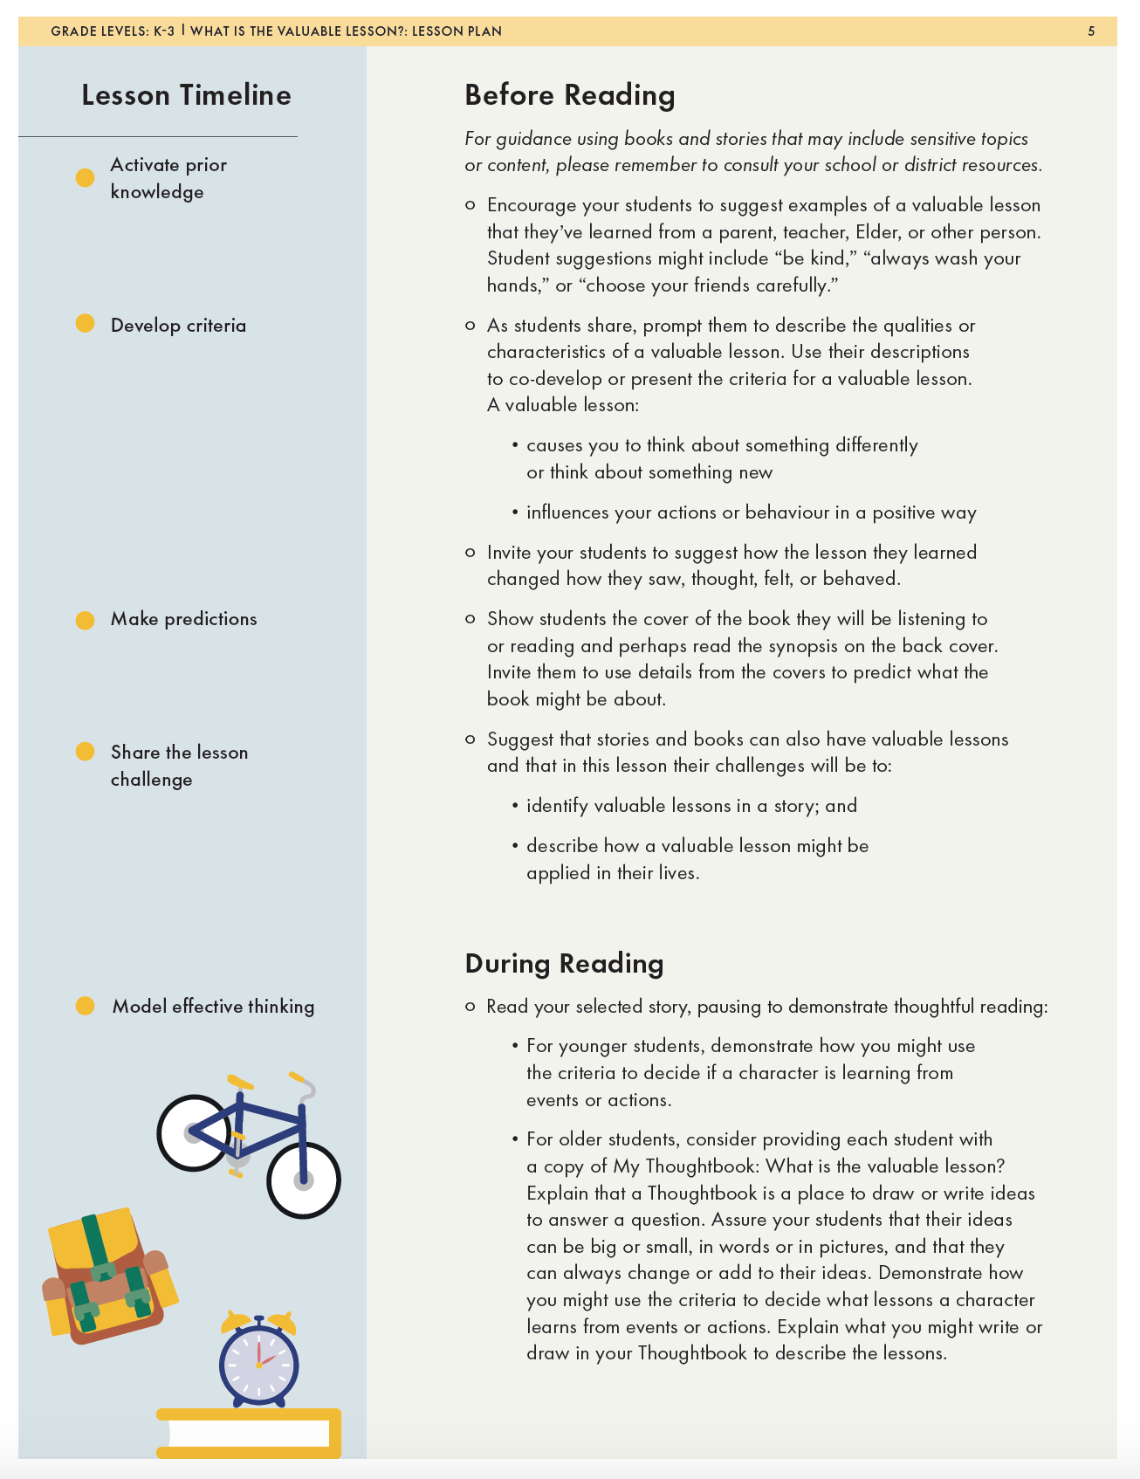
Before Reading:
Introduce the question and challenge
BEFORE READING
Notes:
Delete this slide

Slide 13

During Reading:
Develop criteria
Discuss the differences between respectful and disrespectful actions. Use their ideas to co-develop or share the criteria for a respectful action.
DURING READING: DEVELOP CRITERIA

Slide 14
There is no audio for this slide
During Reading:
Model effective thinking
Consider recording and displaying the criteria for use later
in this lesson. Read your selected story, pausing to demonstrate thoughtful reading:
For younger students, draw the Venn diagram on chart paper or a whiteboard. Consider reading the story in sections, pausing at points to demonstrate how you might notice:
Obvious and less obvious similarities and differences between two characters. Consider noting ideas on a Venn diagram.
DURING READING: MODEL EFFECTIVE THINKING

Slide 15
During Reading:
Model effective thinking
For older students, provide each student with a copy of the Activity sheet: Rating the actions. Prompt students to note two characters from the story, then use events from the story to describe obvious and less obvious similarities and differences between the two characters. Ask students to note any example of actions in the left-hand column of the chart (see the sample Activity sheet sample: Rating the actions).
There is no audio for this slide
DURING READING: MODEL EFFECTIVE THINKING

Slide 16

After Reading:
Review lesson challenges
After reading the story to the class, remind them of the lesson challenges:
Describe how the characters in the story are similar and different.
Decide which actions in the story were the most respectful of differences class.
AFTER READING: REVIEW LESSON CHALLENGES

Slide 17
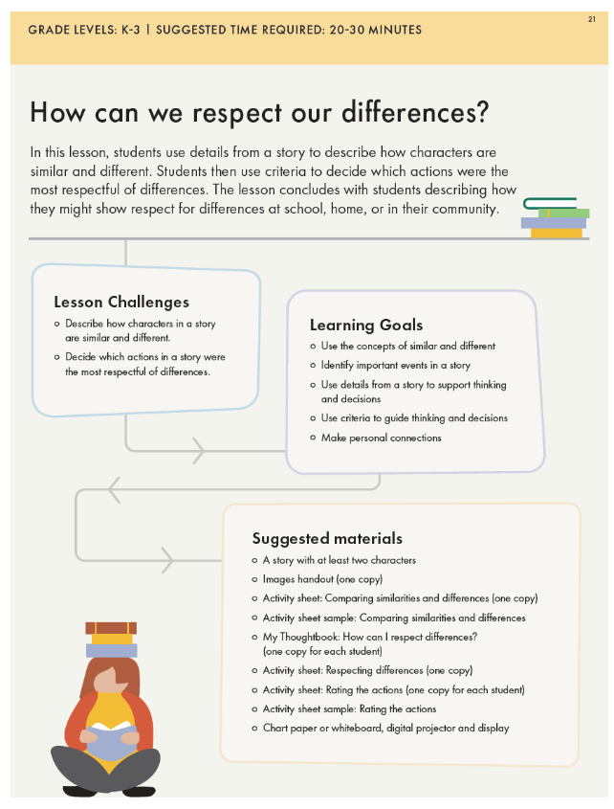

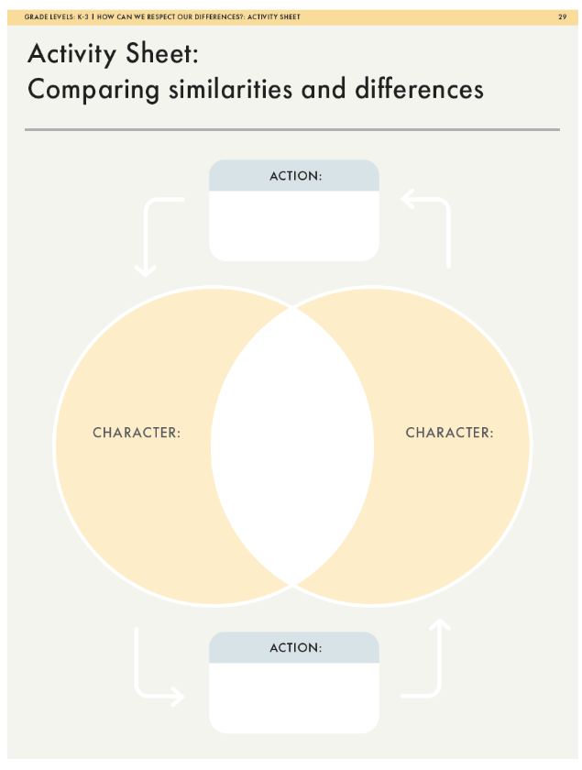
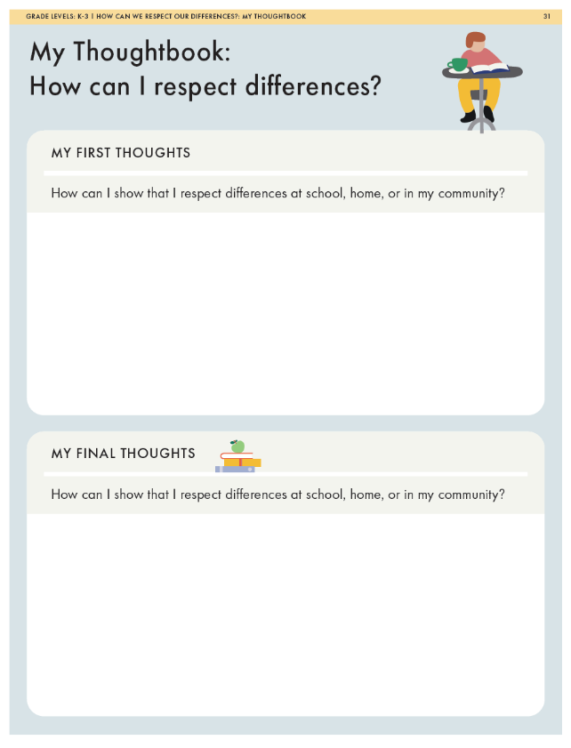
ACTIVITY SHEETS

Slide 18

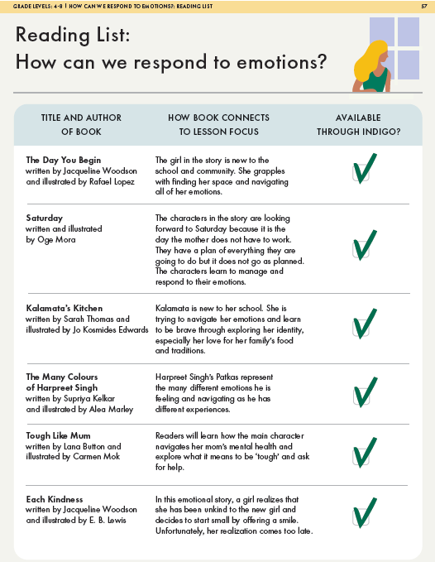
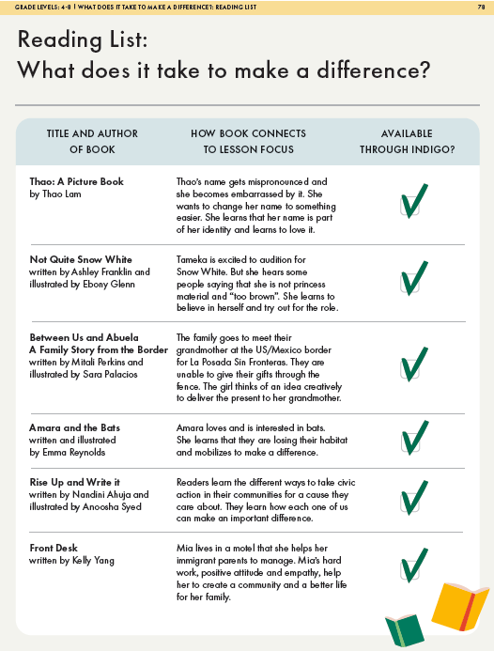
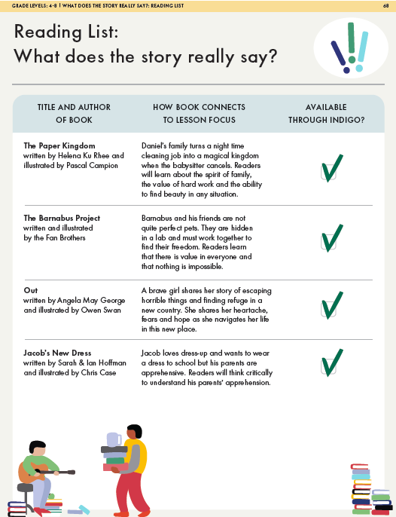
Indigo Love of Reading reading lists
The reading lists that follow each lesson feature books that match each lesson.
42 book suggestions for grades K-3
42 book suggestions for 4-8
INDIGO LOVE OF READING EQUITY AND ANTI-OPPRESSION READING LIST

Slide 19

Impacts of using the
lessons and reading list
Rabia Khokar
Teacher
Education and equity consultant
IMPACTS OF USING THE LESSONS AND READING LIST

Slide 20
Impacts of using the
lessons and reading list
When asked about student responses to the lessons:
I really like the think time and reflection time to give students. Returning to the same questions….or else we are always moving and students do not have the opportunity to connect back to the process – Kerry
We were fostering natural curiosity from the very beginning - tapping into curiosity and then creating a need for information. You want them to be hungry - create a need for vocabulary as part of wanting to communicate - Meaghan
When asked what’s important in their practice:
“Choosing rich mentor texts that promote awareness and challenge the norms of a predominately white society. Widening a student's perspective and point of view by creating a safe forum to discuss and promote cultural awareness- where asking questions is valued.” - Meaghan
There is no audio for this slide
IMPACTS OF USING THE LESSONS AND READING LIST

Slide 21
Revisit your Thoughtbook
What are your thoughts about this question and challenge now?
Inquiry question:
What does learning that nurtures literacy and inspires
a love of reading look like?
Challenge:
Identify key components of the lessons that will invite your students to think deeply and meaningfully engage them in reading.
REVISIT YOUR THOUGHTBOOK

Slide 22
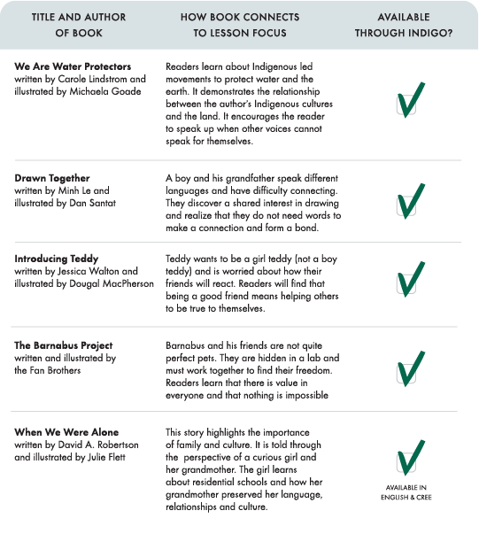
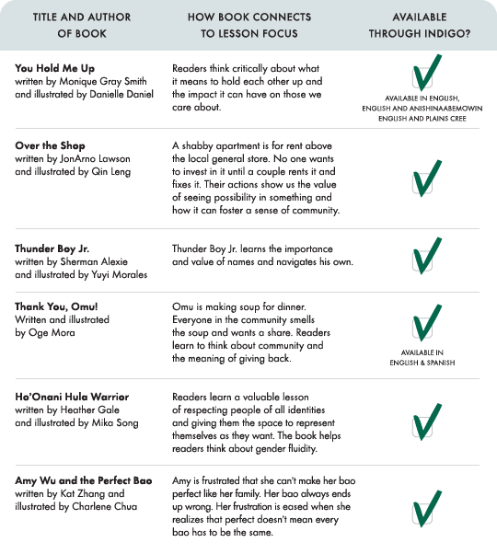
Closure
CLOSURE

Slide 23




Thank you!
Usha James
usha.james@mail.utoronto.ca
@Ushajames
www.tc2.ca
@tc2thinks
There is no audio for this slide
THANK YOU

